Slide 1

All-in-one Projector Kit

Slide 2

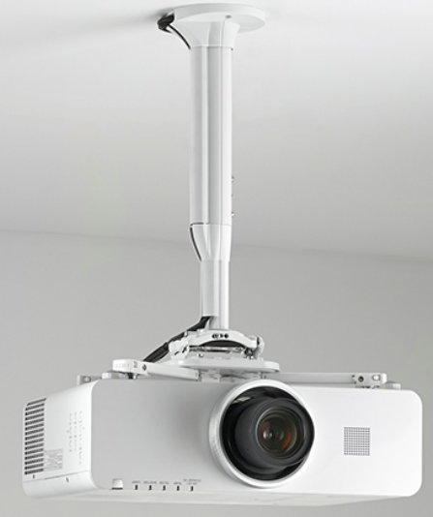
All-in-one Projector Kits | 22 KG - Introduction
The KITMC Series projector kits include everything needed for most projector installations. This bundled kit includes the RPMEU (22 kg) projector mount, CPA116 ceiling plate, a telescoping column and a decorative shield ring for a nice and clean finish.

Slide 3
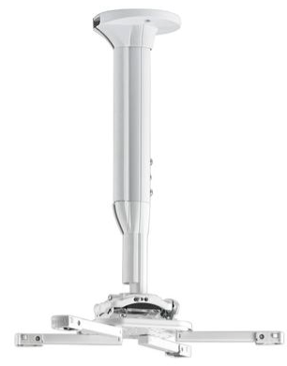
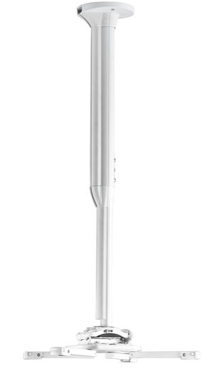
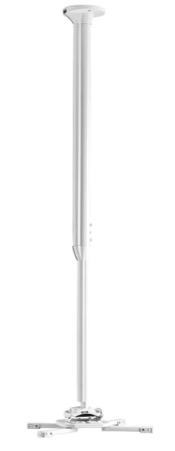
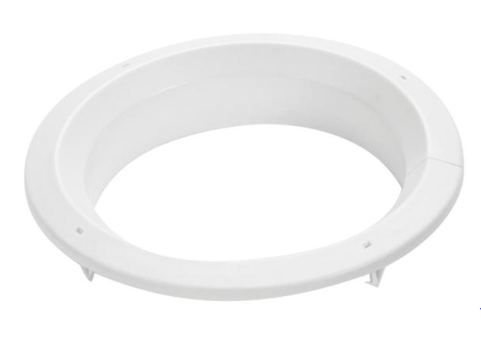
All-in-one Projector Kits | 22 KG
KITMC All-in-One Kits include:
RPMAU Mini Elite™ Security Projector Mount
Telescoping Extension Column
CPA116 Ceiling Plate
Integrated Cable Management
All-Points-Security kit
Finishing ring for Suspended Ceilings
KITMC030045
Adjustable 300-450 mm
KITMC045080
Adjustable 450-800 mm
KITMC080135
Adjustable 800-1350 mm

Slide 4
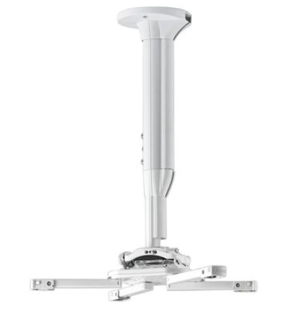
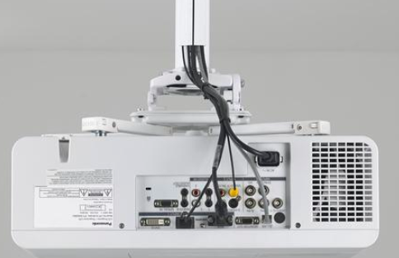
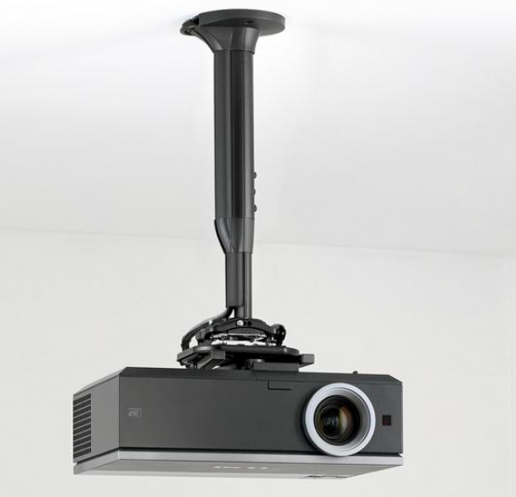
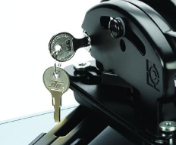
All-in-one Projector Kits | 22 KG
TELESCOPING CAPABILITY
Infinite smooth projector mount
height positioning
CABLE MANAGEMENT
Inlay style external cable management
for easy installation and serviceability.
Easily conceals 5 cables
.
STYLISH DESIGNS
Choose black or white
Q-LOCK™ QUICK RELEASE LEVER
Provides quick connect/disconnect of the projector for enhanced security with an integrated key and lock system

Slide 5
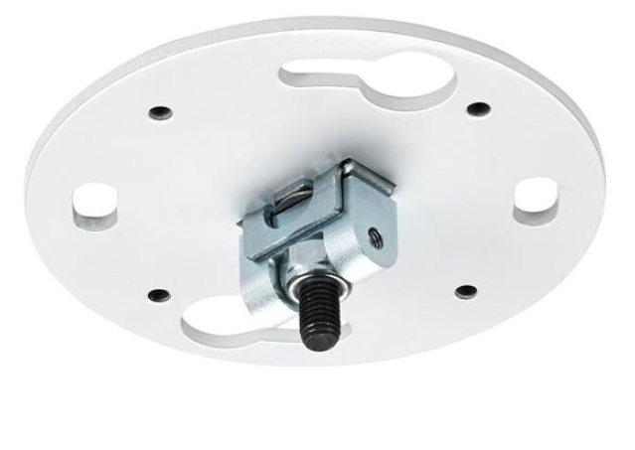
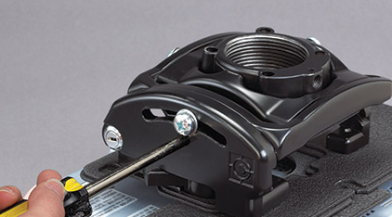
All-in-one Projector Kits | 22 KG
CABLE MANAGEMENT
Inlay style external cable management
for easy installation and serviceability.
Easily conceals 5 cables
.
AN EVEN FASTER INSTALLATION
Teardrop shaped mounting slots allows predrilling and quick ceiling attachment
INCREASED RIGIDITY
New Ceiling plate <> column connection tightens ceiling plate to inside of column
MICROZONE™ ADJUSTMENTS
Fast & precise projector registration using independent roll, pitch and yaw settings.

Slide 6
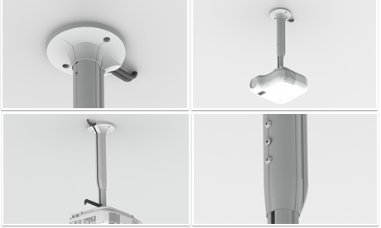

All-in-one Projector Kits | 22 KG
Quick service design features
Universal interface keeps registration when disconnected from the projector mount.
This eliminates the need to re-install the Universal interface when lamps or filters are serviced.
Projector mount maintains all axis registration when the projector is disconnected from the projector
Fully integrated cable management – accepts up to 4 cables
Enhanced esthetics, sleek look
MicroZone Adjustments make projector registration fast and precise
Q-Lock Quick Release Lever provides quick connect / disconnect
of the projector for service
Integrated enhanced security
  Integrated key and lock system
  All points security hardware standard included
Ships fully assembled

